Slide 1


Movie Recommendation System
Group:290
Shreeyesh Chauhan(A20449780)
Manasi Shah(A20454824)
Gauri Khatri(A20443345)

Slide 2

Introduction
A recommendation system provides suggestions to the users through a filtering process that is based on user preferences and content based.
The information about the user is taken as an input. This information reflects the prior usage of the product as well as the assigned ratings.
A recommendation system is a platform that provides its users with various contents based on their preferences and likings.
We aim to build 3 types of recommendation system – Demographic filtering, Content Based filtering and Collaborative filtering.

Slide 3
Research Problem
In today’s world, every customer is faced with multiple choices. They might waste a lot of time browsing around on the internet and trawling through various sites hoping to strike gold. Without recommendation system they might waste time on various sites.
Therefore, the recommendation systems are important as they help them make the right choices, without having to expend their cognitive resources.
The proposed methodology of Movies Recommendation System deals with different stages of the project which consists of data collection, data preprocessing, model generation, prediction and outcomes.

Slide 4
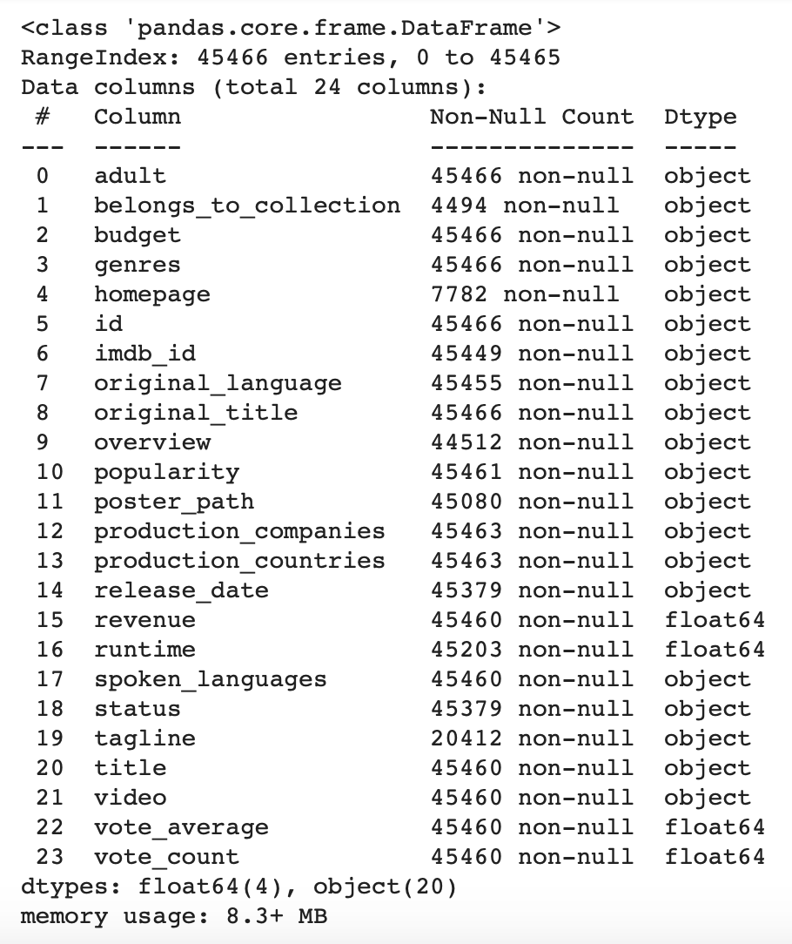
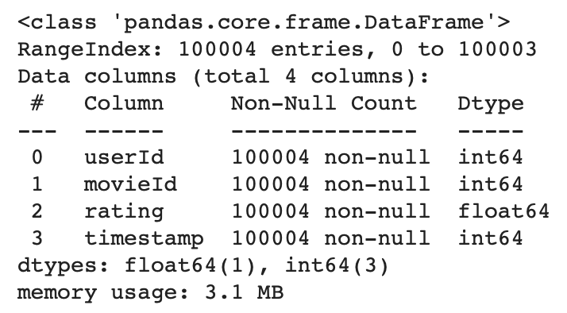
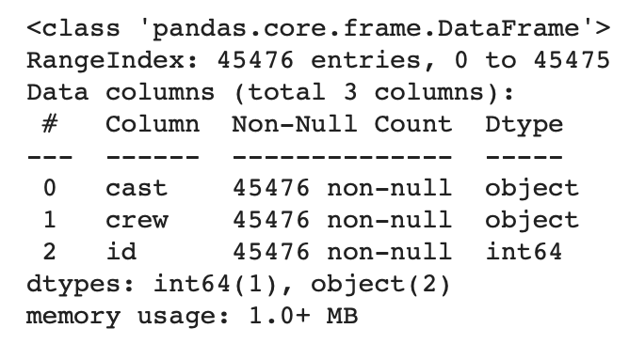
Dataset
The dataset has 7 files and 45K+ instances.
We have used 3 csv files (movies_metadata, credits and small_ratings)

Slide 5
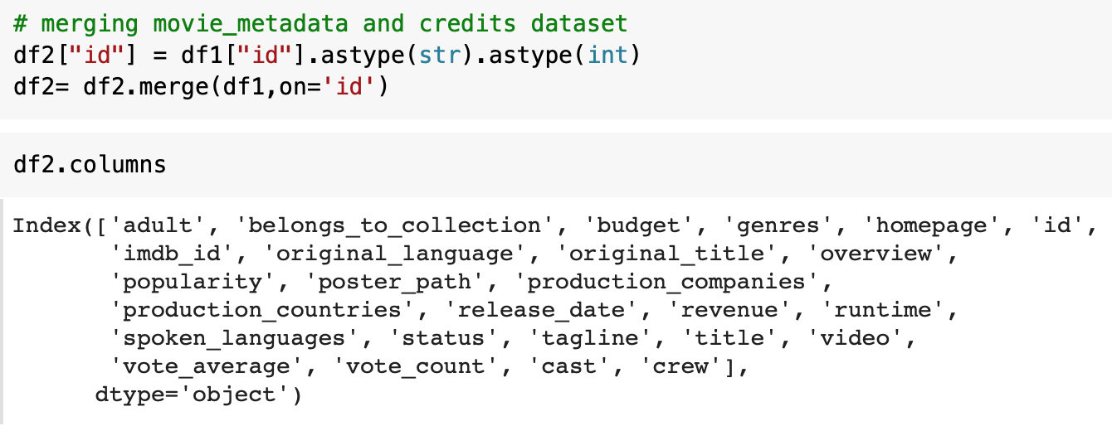
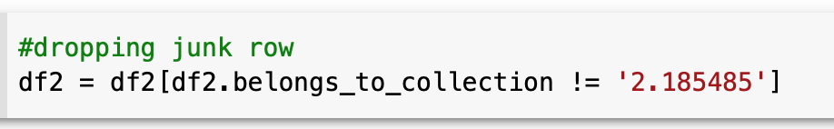
Data Pre-Processing
Merging Two Datasets
Dropping Junk Row

Slide 6
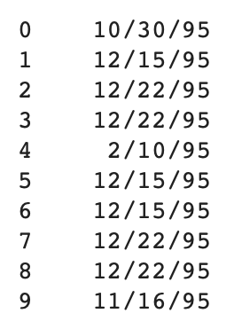
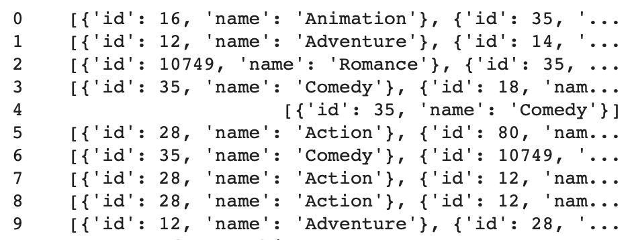
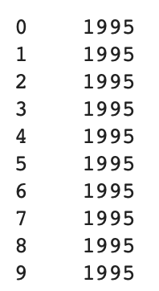
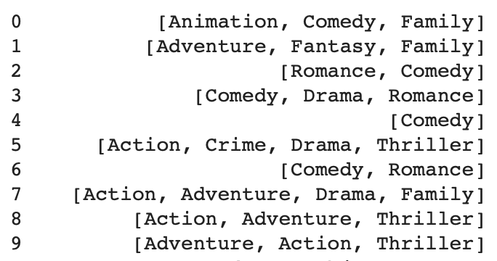
Data Pre-Processing
Year & Genre

Slide 7
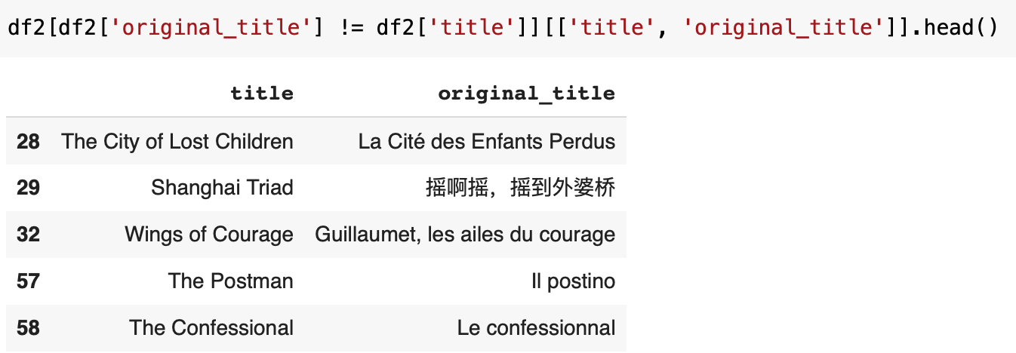
Data Pre-Processing
Original Title
Dropping Unwanted Columns

Slide 8
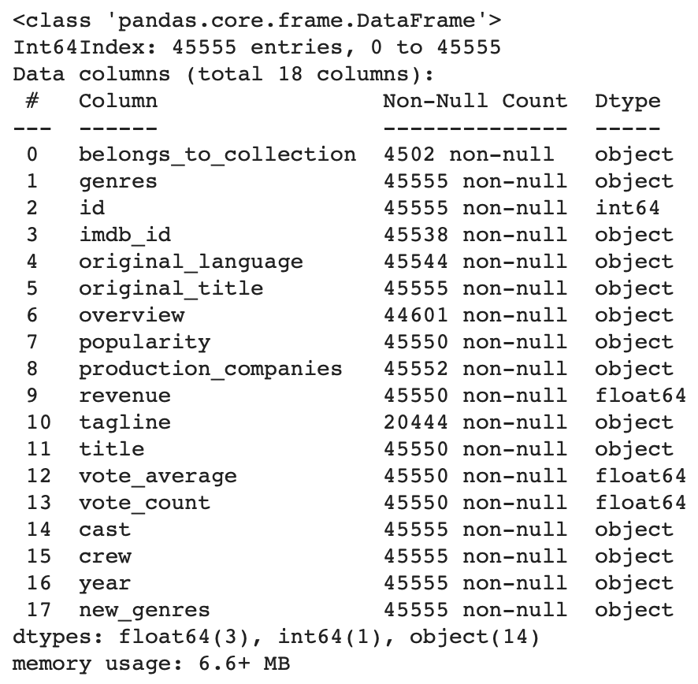
Final Dataset

Slide 9
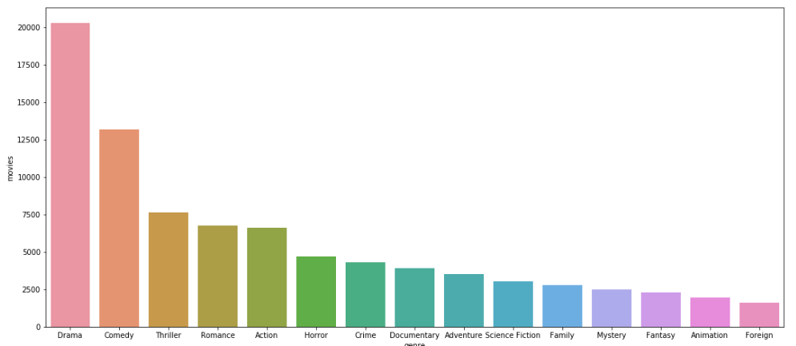
Data Visualization
Different Genres

Slide 10
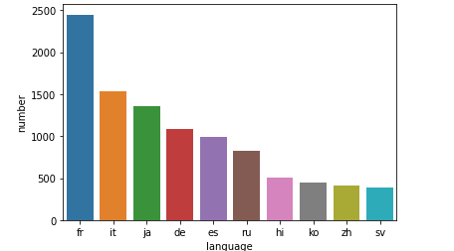
Data Visualization
Different Languages

Slide 11
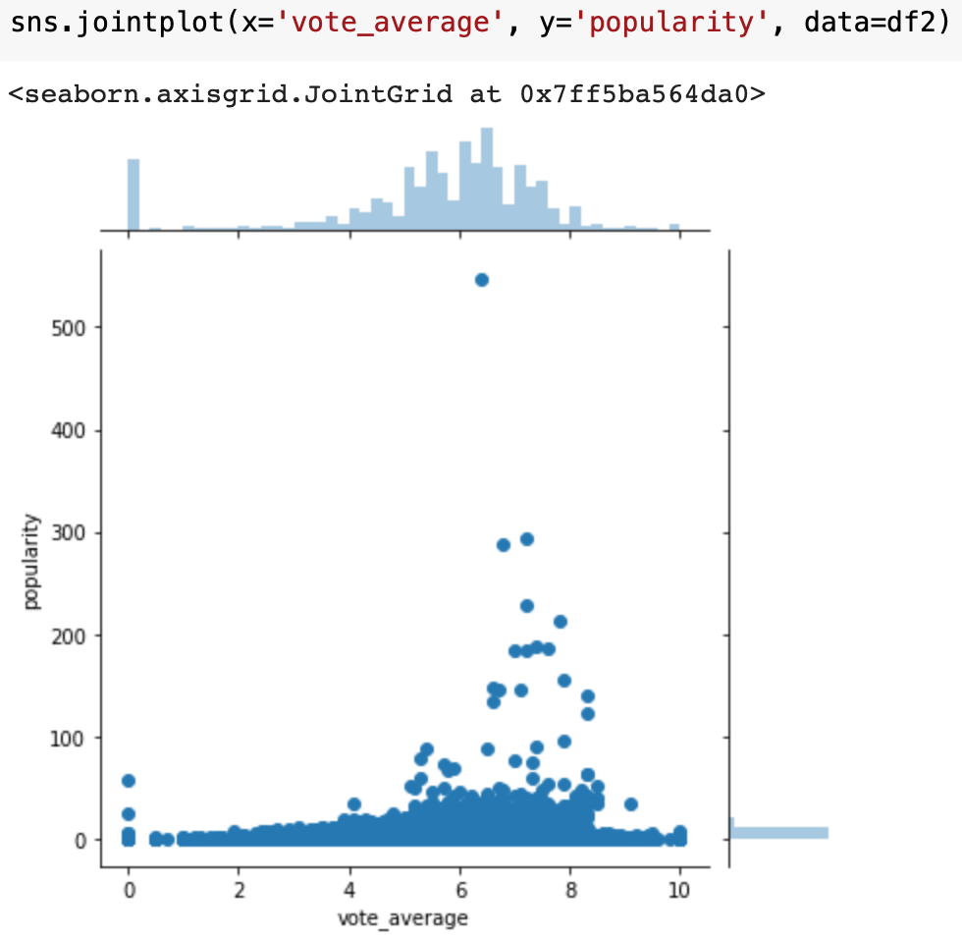
Data Analysis
Do popularity and vote average share a tangible relationship?

Slide 12

Data Analysis
Is Vote Count and Vote Average related?

Slide 13
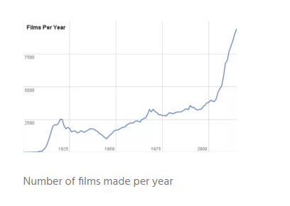
Data Analysis
Movies releases per year

Slide 14
Recommendation System
Demographic Filtering
> On basis of IMDB Score
> On basis of Genre
Content Based Filtering
> Overview & Tagline
> Cast, Crew & Genre
Collaborative Filtering
> User-Based (Rating)

Slide 15
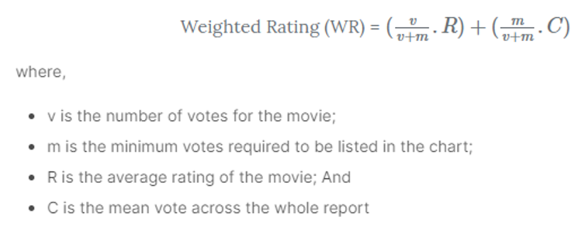
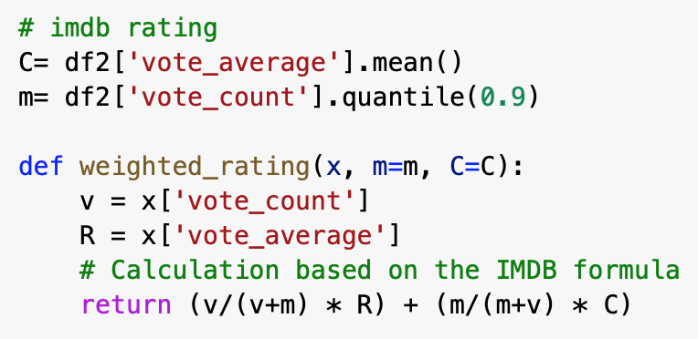
Demographic Filtering
On basis of IMDB score

Slide 16
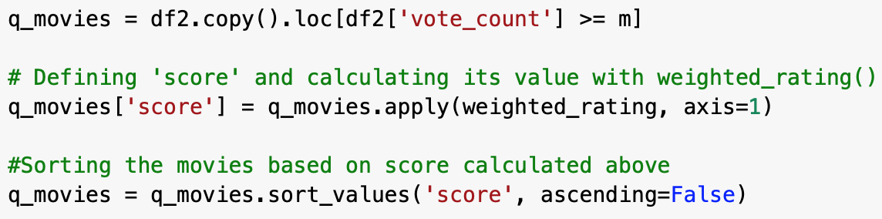
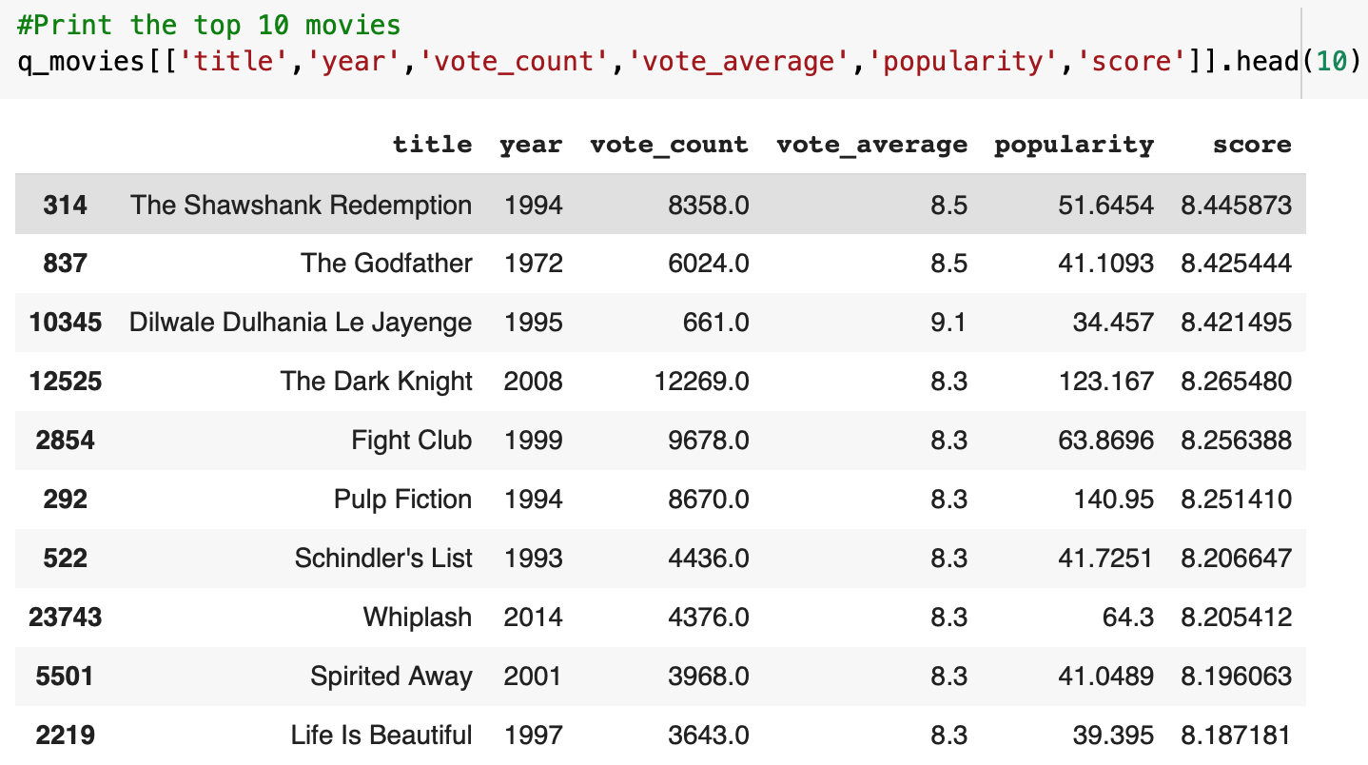
Demographic Filtering
On basis of IMDB score

Slide 17
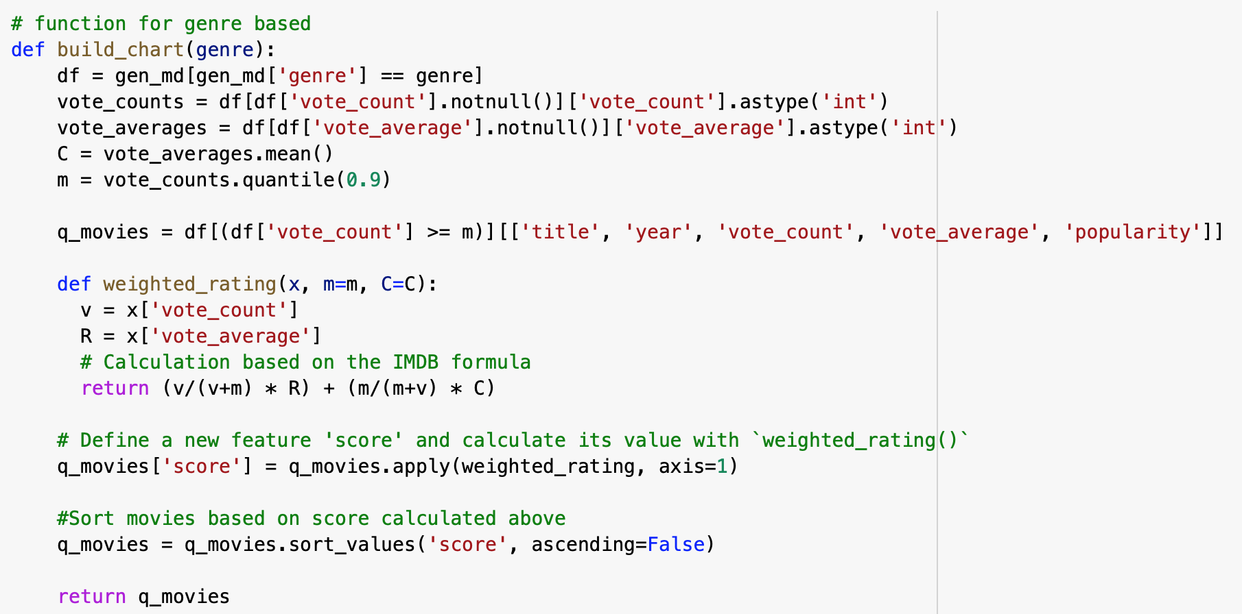
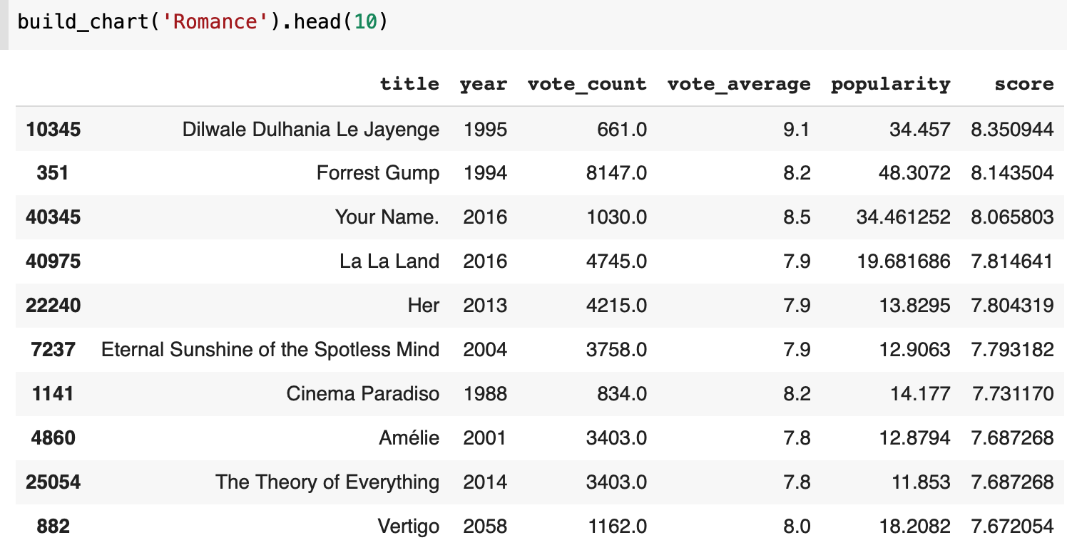
Demographic Filtering
On basis of Genre

Slide 18
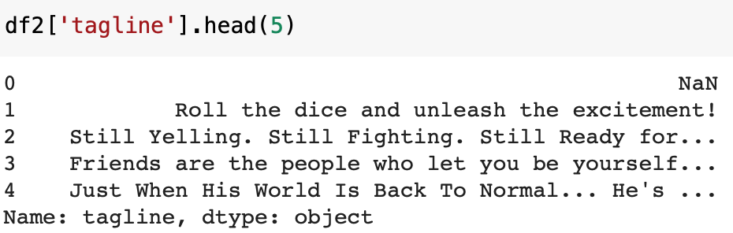
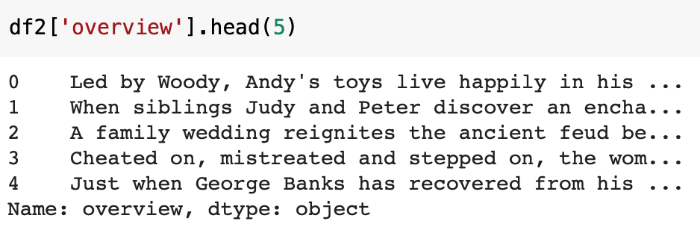
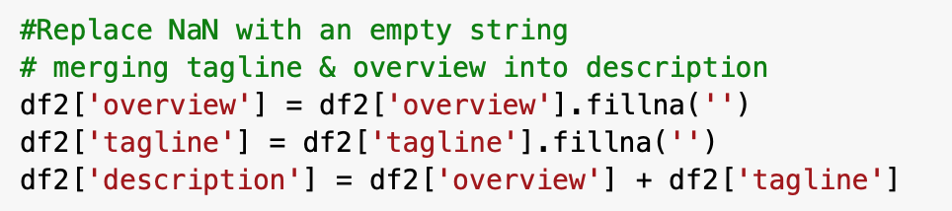
Content-Based Filtering
Overview & Tagline

Slide 19
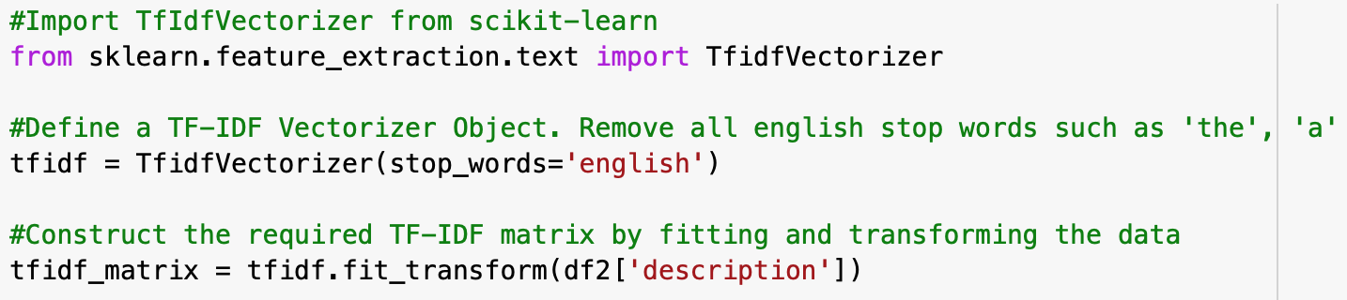
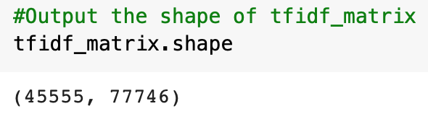
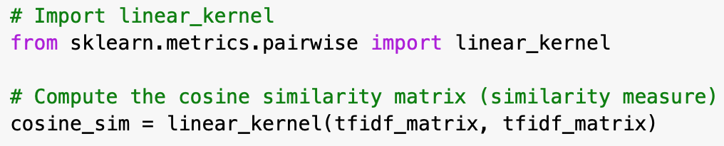
Content-Based Filtering
Overview & Tagline

Slide 20
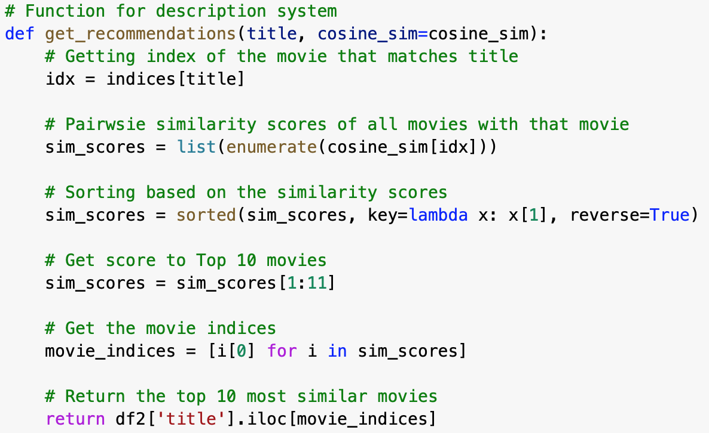
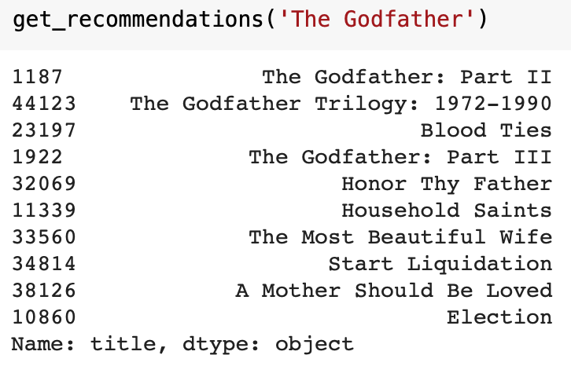
Content-Based Filtering
Overview & Tagline

Slide 21
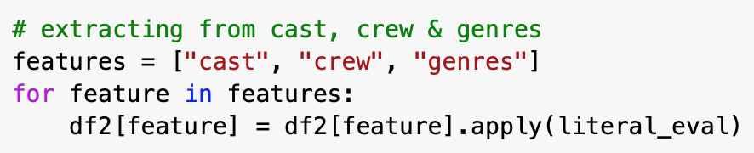
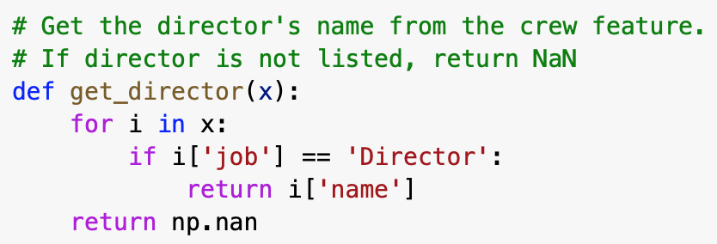
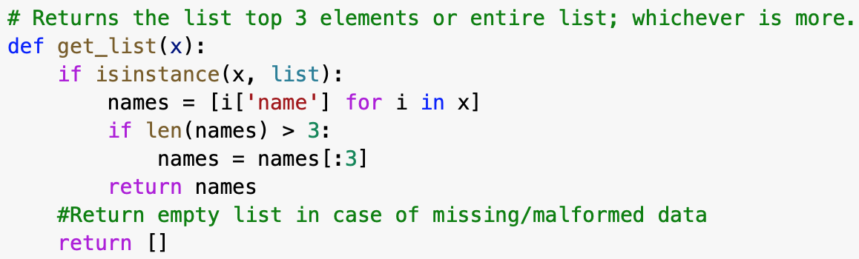
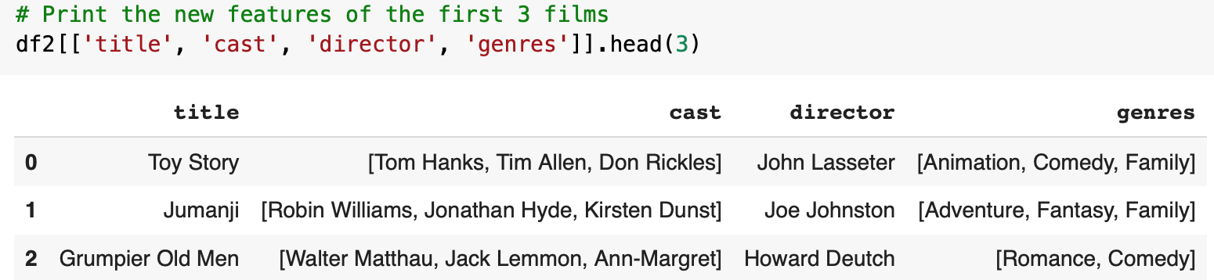
Content-Based Filtering
Cast, Crew & Genre

Slide 22
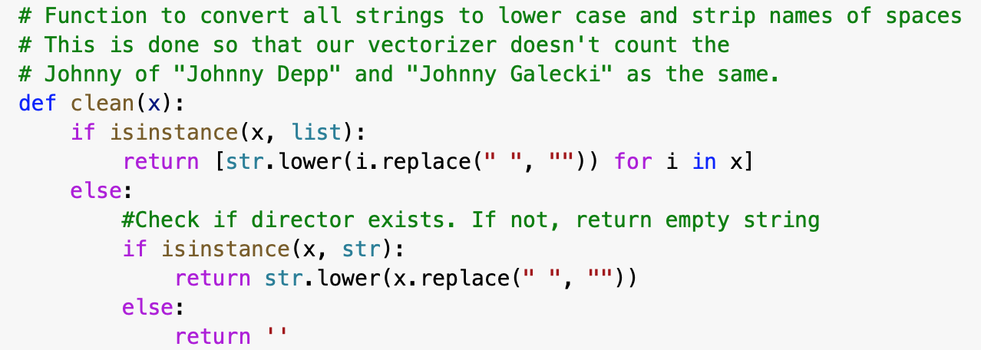
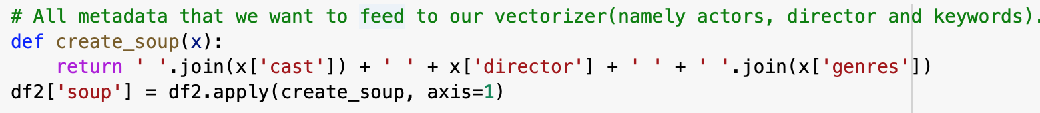
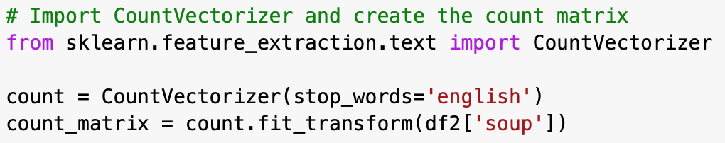
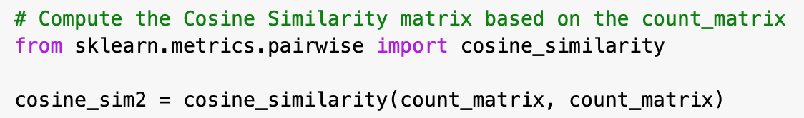
Content-Based Filtering
Cast, Crew & Genre

Slide 23
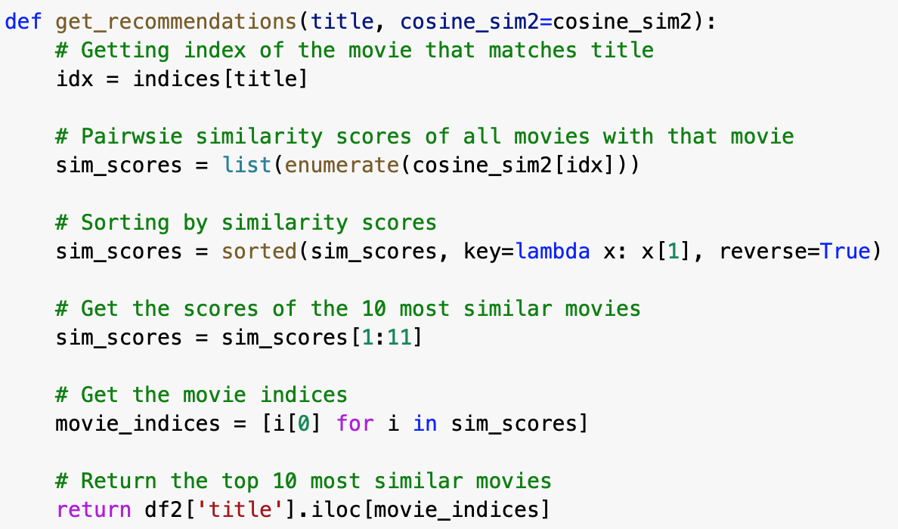
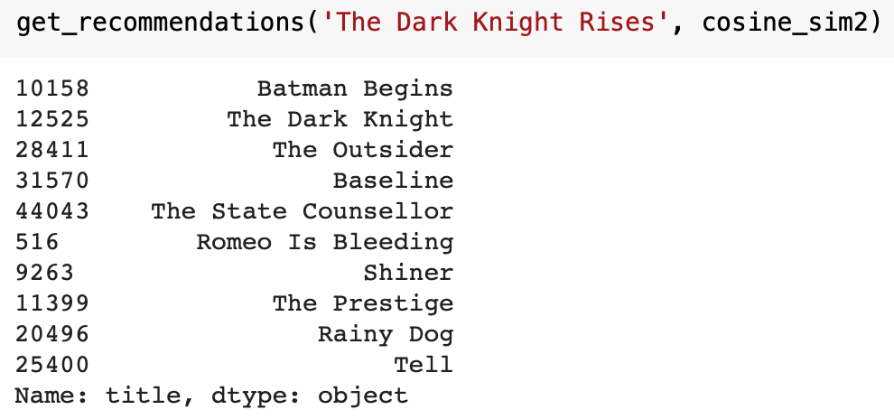
Content-Based Filtering
Cast, Crew & Genre

Slide 24
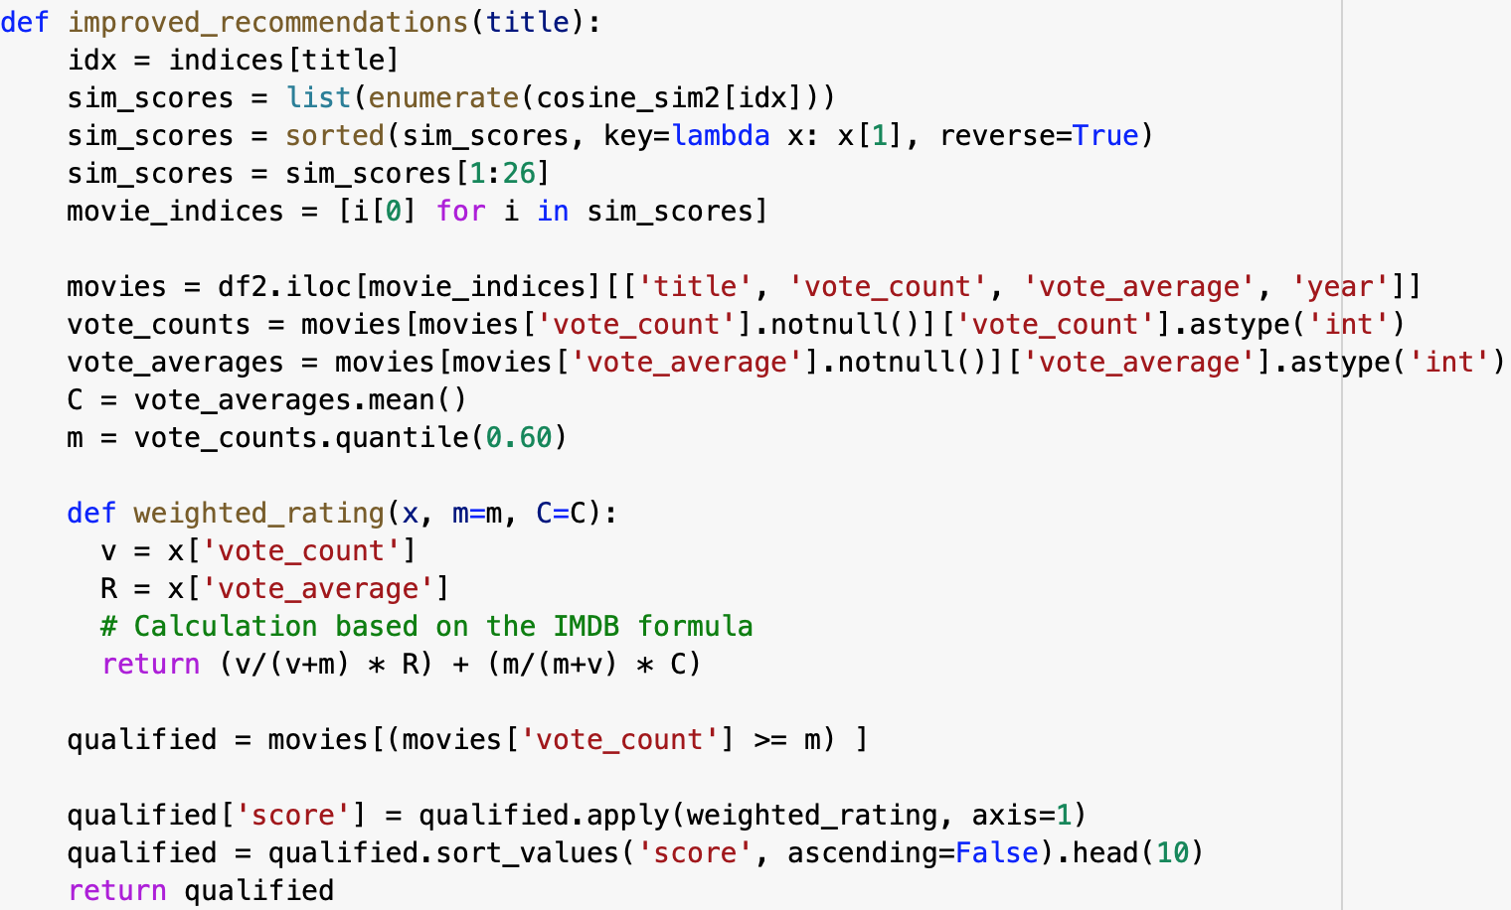
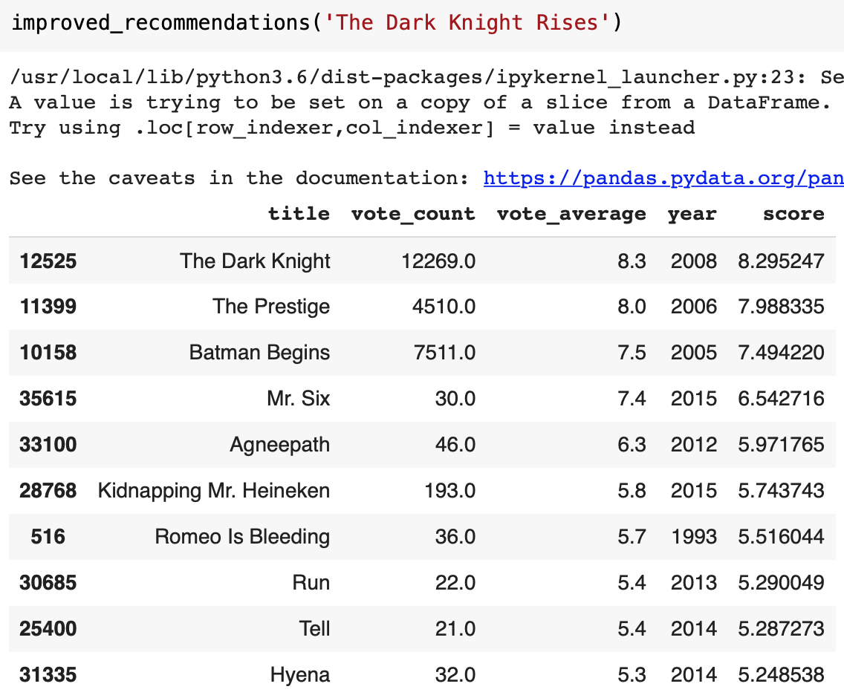
Content-Based Filtering
New Improved System

Slide 25
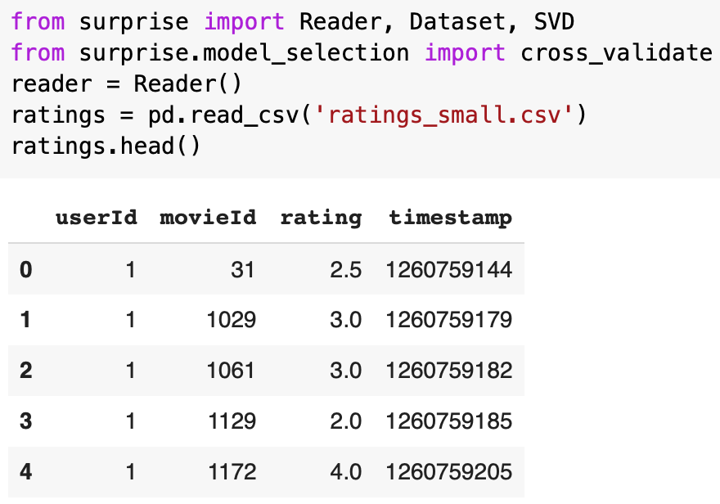
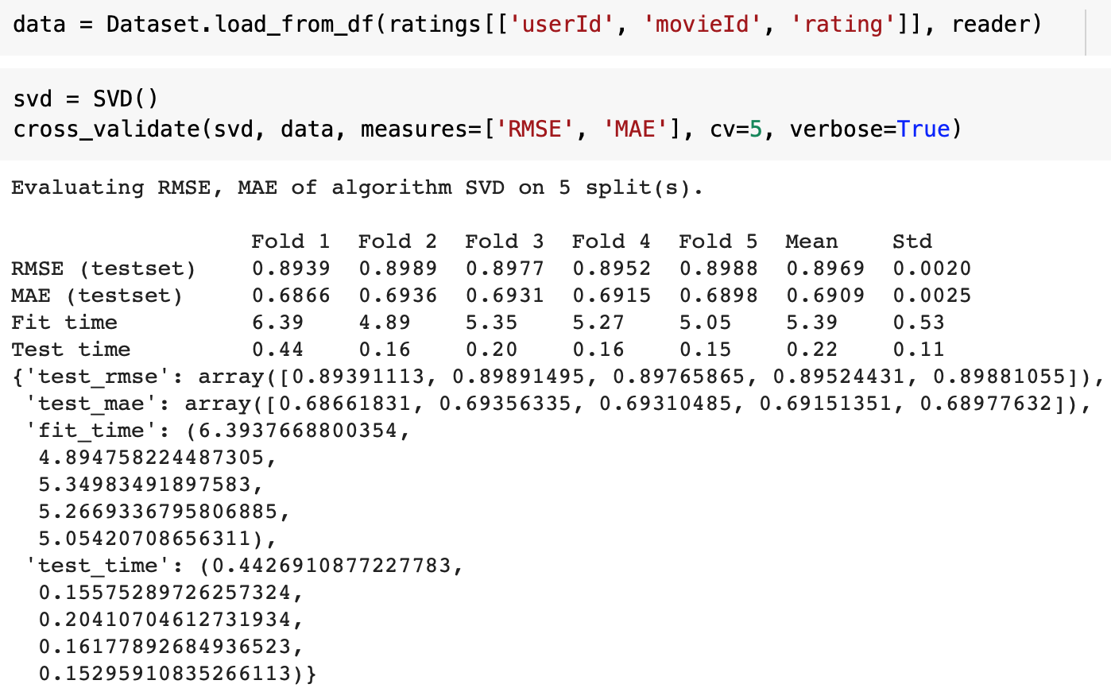
Collaborative Filtering
User-Based Rating

Slide 26
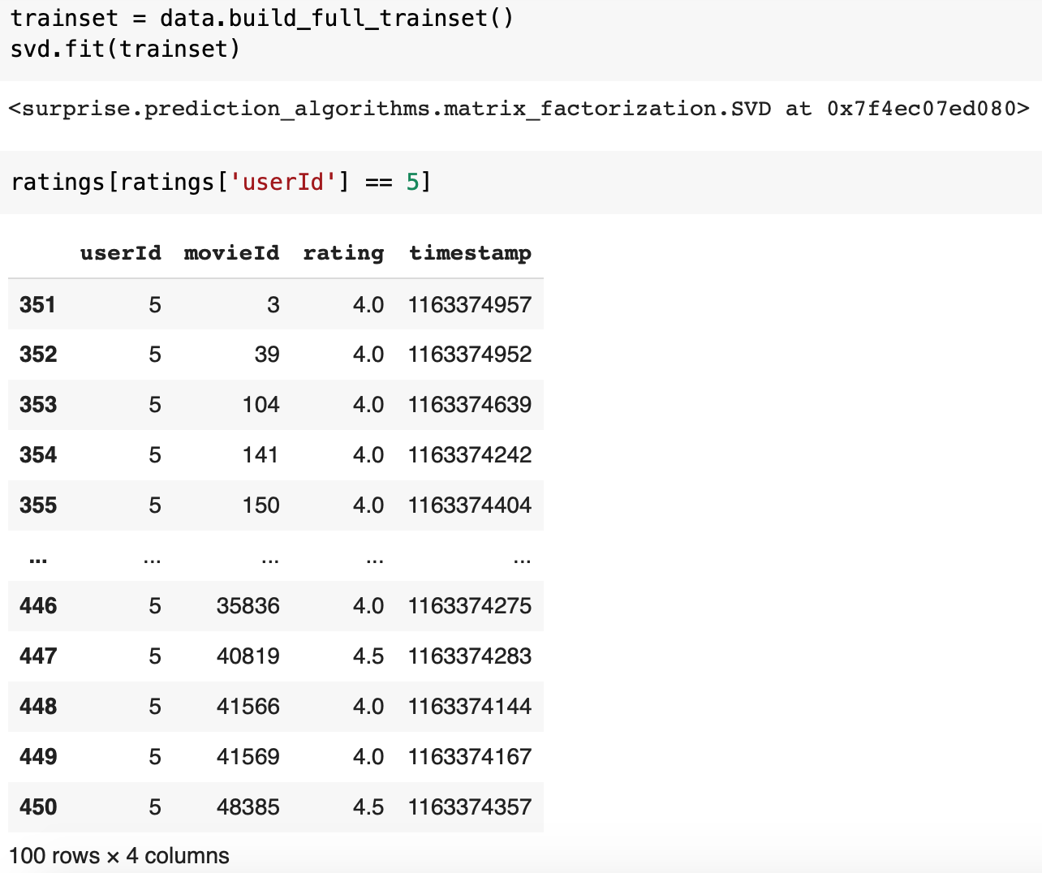
Collaborative Filtering
User-Based Rating

Slide 27
Comparative Analysis and Conclusion
With this system, user will get new movie suggestions based on user queries by recommending the Top 10 movies which would save lot of their time and resources.
Companies can make use of the system and can benefit from it by generating more revenue

Slide 28
Thank you

